Slide 1

December 13, 2018
Wifi: 1393Conference
Password: kayla1393

Slide 2

Welcome & Introductions
Paul Love, MPH
Data analyst
plove@nshc.org
(631) 257-6956
www.lihealthcollab.org

Slide 3
LIHC Strategic Plan
LIHC Strategic Plan update approved by the Steering Committee
Updates include,
  Program background, strategy, implementation, evaluation
  Core Clusters and reference to our September 2017 Collective Impact Think Tank
  New short- and long-term evaluation overviews
  Updated SWOT Analysis of the Long Island Health Collaborative
www.lihealthcollab.org

Slide 4
2018 Look Back
Our biggest accomplishments
Food Access Cluster
  Completed logic model and began development of collective data dashboard
Cultural Competency Health Literacy program
  The continued growth, constant feedback and the ongoing improvement
  LGBTQ Consortium
Library Asset Mapping Project
  With Stony Brook University, over 50% of targeted libraries interviewed
www.lihealthcollab.org

Slide 5
2018 Look Back
Collaboration with other grants and initiatives
  Kohl’s Keeping Kids Healthy/Cohen Children’s Medical Center, Eat Smart NY, Pedestrian Safety Grant/GTSC, Northwell Health’s BFREERHIO contracts
Data output
  Thematic Reports
www.lihealthcollab.org

Slide 6
2019 Look Forward
Already in progress
Food Access Cluster’s goal setting
Community Health Needs Assessments
  Informed by consumer level focus groups and
  CBO key informant interviews
Cultural Competency Health Literacy
  Refresher session and continued expansion
Website improvements
  For member engagement and new member consideration
Library Asset Mapping
  Project wrap up and publication
www.lihealthcollab.org

Slide 7
2019 Look Forward
New projects for the new year
Community Health Needs Assessments
  Community member survey analysis for 2018
Chronic Disease Self-management Facilitation
  Working together with experts in the region
Wellness Portal
Population Health Dashboard Update
www.lihealthcollab.org

Slide 8
Networking break
www.lihealthcollab.org

Slide 9

www.lihealthcollab.org

Slide 10

LGBTQ Health
Part 1: Introduction to lesbian, gay, bisexual, transgender, queer/questioning (LGBTQ) health

Slide 11
Defining Implicit Bias
An implicit bias is a positive or negative mental attitude/thought toward a person, thing, or group that an individual has
It is unconscious, opposed to an explicit bias
In simple terms, our brains are always quietly drawing conclusions, many of which are based on incomplete information and completely invisible to our conscious minds

Slide 12
One way to identify your own biases is to take the Implicit Association Test (IAT) which measures attitudes and beliefs that people may be unwilling or unable to report
https://implicit.harvard.edu/implicit/takeatest.html
Notes:
Project Implicit is a non-profit organization and international collaborative network of researchers investigating implicit social cognition - thoughts and feelings outside of conscious awareness and control. Project Implicit is the product of a team of scientists whose research produces new ways of understanding attitudes, stereotypes and other hidden biases that influence perception, judgment, and action.
We asked you to complete the Sexuality ('Gay - Straight' IAT).
This IAT requires the ability to distinguish words and symbols representing gay and straight people. It often reveals an automatic preference for straight relative to gay people. “Gay-Straight”
How did it feel to complete this test? Were you surprised by the results? Why or Why Not?

Slide 13
Implicit biases are not permanent; they are malleable and can be changed by devoting intention, attention, and time to developing new attitudes
Change takes a concerted effort
Successful approaches in change include identifying the bias(es), openly acknowledging them, and directly challenging or refuting them

Slide 14
An irrational attitude or hostility directed against an individual or group based upon supposed characteristics
May be overt or subtle, intentional or unintentional
Prejudice

Slide 15
Homophobia irrational fear of, aversion to, or discrimination against lesbian, bisexual and/or gay people
Transphobia irrational fear of, aversion to, or discrimination against transgender or gender diverse people
Heterosexism the system of advantages bestowed on heterosexuals (and subsequent disadvantages experienced by sexual and gender minorities)
It is the institutional form of homophobia in society by assuming all people are or should be heterosexual and therefore excludes the needs, concerns or life experiences of sexual and gender minority people

Slide 16
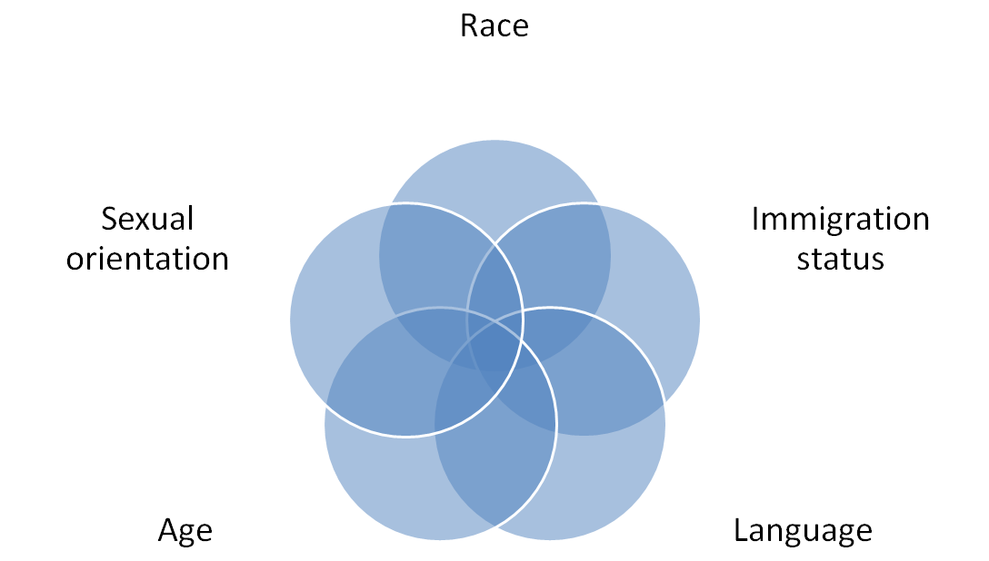
Intersectionality
Having multiple oppressed identities (race, ethnicity, class, gender, sexual orientation, age, language, ability, etc.) affects physical and mental health, well-being, and health-seeking behaviors
Notes:
Minority Stress Ilan Meyer 2003

Slide 17
Privilege and Power
An unearned right or advantage granted to some, but not everyone

Slide 18
“For those with privilege, the wind is at their back and helps them move forward with little effort. Those without privilege are facing the wind and struggle against its strength”
- Michael Kimmel

Slide 19
Making the Connection
Membership in multiple privilege groups result in additional invisible privileges
Members with the most privileges tend to have the most power in society
For today’s training we’ll be discussing the impact of heterosexual and cisgender privileges
Notes:
Other examples of privilege: white, male, able-bodies, Christian

Slide 20
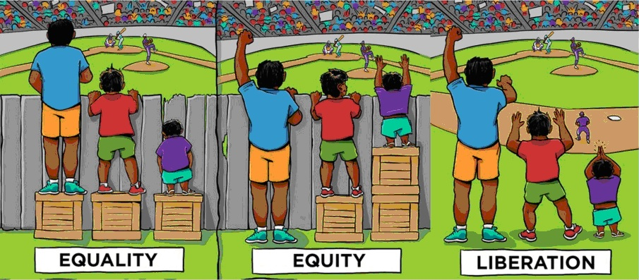
“Privilege is not in and of itself bad; what matters is what we do with privilege” – Bell Hooks

Slide 21
Addressing Privilege
Inequities and discrimination occur when power and privilege are not equally shared by all members of society
Legislative attempts to level the playing field have not always been successful
  Inequities that are part of a society’s structure or system are not always adequately addressed by laws
  Laws have no power when addressing invisible privilege
Notes:
Examples:
Supreme Court ruling in 2015 to legalize same-sex marriage
Repeal of “Don’t Ask, Don’t Tell”; Trump issuing directive banning transgender individuals from serving in the military
‘Religious Freedom’ bills to allow bias and discrimination (refusing to serve members of the LGBT Community)
No national protection for employment discrimination
‘Bathroom Bills’ targeting Trans or Gender Diverse people

Slide 22
LGBTQ Health
Part 2: lgbtq 101 & vocabulary

Slide 23

Sexual Orientation
A person’s physical, romantic, emotional, aesthetic, and/or other form of attraction to others

Slide 24
Examples of Sexual Orientation
Gay - The adjective used to describe people whose enduring physical, romantic, and/ or emotional attractions are to people of the same gender
Lesbian - A woman whose enduring physical, romantic, and/or emotional attraction is to other women
Bisexual - A person who has the capacity to form enduring physical, romantic, and/ or emotional attractions to those of the same gender or to those of another gender

Slide 25
What is Gender?
Internal Feelings/Identity
Outward Expression
Social Norms

Slide 26
What is Sex?
Sex: One’s biological and physical attributes––external genitalia, sex chromosomes, hormones, and internal reproductive structures that are used to assign someone as male or female or intersex at birth. Sex is not a binary
Sex Assigned at Birth: This is generally determined by external genitalia at birth––female, male or intersex

Slide 27

Gender Identity
One’s innermost concept of self as male, female, a blend of both or neither – how individuals perceive themselves and what they call themselves
One’s gender identity can be the same or different from their sex assigned at birth

Slide 28

Gender Expression
The physical manifestation of one’s gender identity through clothing, hairstyle, voice, body shape, etc which may or may not conform to socially defined behaviors and characteristics typically associated with being either masculine or feminine

Slide 29


Gender Expectation
A stereotypical role that society associates with gender that includes personality traits, domestic behaviors, occupations, and physical appearances

Slide 30
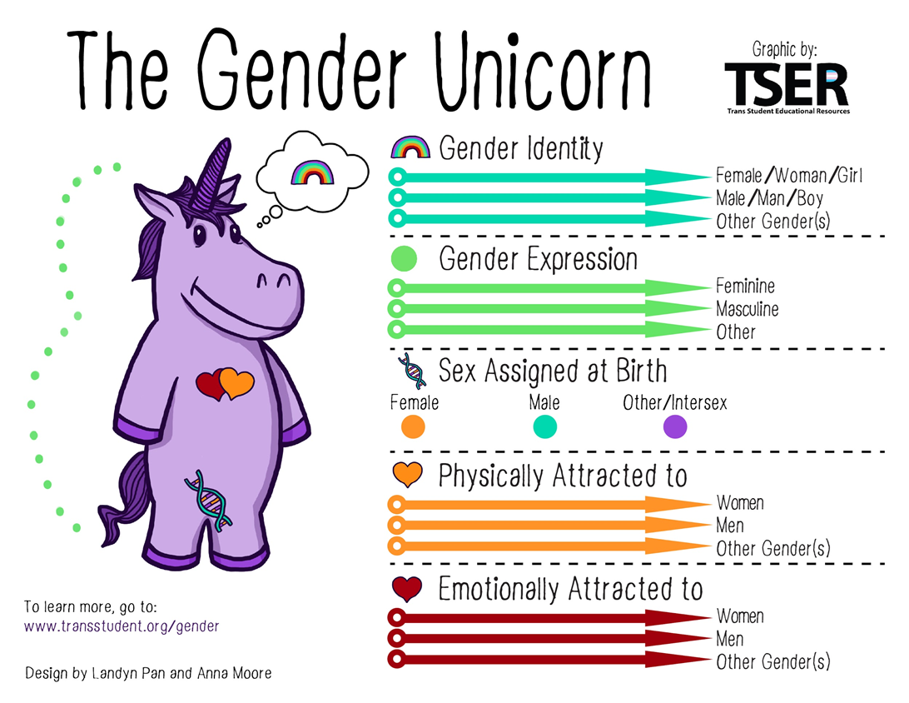

Slide 31
Your sexual orientation is who you are attracted to
Your gender identity is who you are
How you present your gender is your gender expression
Not everyone conforms to society’s gender expectations

Slide 32
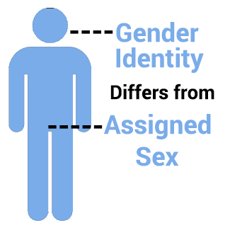
Transgender
An umbrella term used to describe people whose gender identity differs from the sex they were assigned at birth

Slide 33
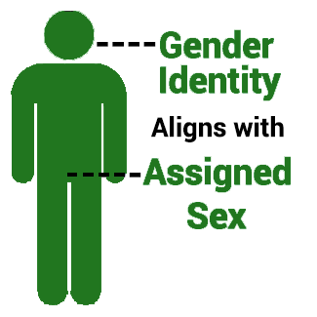
Cisgender
A term for people whose gender identity matches the sex that they were assigned at birth
Cis is a latin term meaning the same
The word “cisgender” was officially added to Webster’s dictionary In April 2017

Slide 34

Non-Binary
Describes any gender identity which does not fit the male and female binary. This can include people who feel their gender is a mix of both, changes often, is something totally separate, or have no strong sense of a gender at all
Not all non-binary people identify as transgender and not all transgender people identify as non-binary
Sometimes (and increasingly), non-binary can be used to describe the aesthetic/presentation/expression of a cisgender or transgender person

Slide 35
Pronouns
In addition to using someone’s name, people frequently refer to each other using pronouns. Often, when speaking of a singular human in the third person, these pronouns have a gender implied -- such as “he or him” to refer to a man or “she or her” to refer to a woman. These associations are not always accurate or helpful

Slide 36
Why Do Pronouns Matter?
When someone is referred to with the wrong pronoun, it can make them feel disrespected, invalidated, dismissed, alienated, or dysphoric (often all of the above)
You can’t always know what someone’s pronouns are by looking at them
Rather than assume someone’s pronouns based on their perceived gender or appearance, it is better to ask what their pronouns are

Slide 37
Gender Neutral Pronouns
“They,” “them,” and “their” are gender-neutral and can be used as singular gender-neutral pronouns
“Zie” (pronounced “z”) is subjective and can be used instead of “she” or “he”
“Hir” (pronounced “here”) is both objective and possessive and is used instead of “him,” “his,” “her,” and “hers”
Using “it” to refer to people is offensive and dehumanizing, so make sure to stick with gender-neutral pronouns when appropriate!

Slide 38
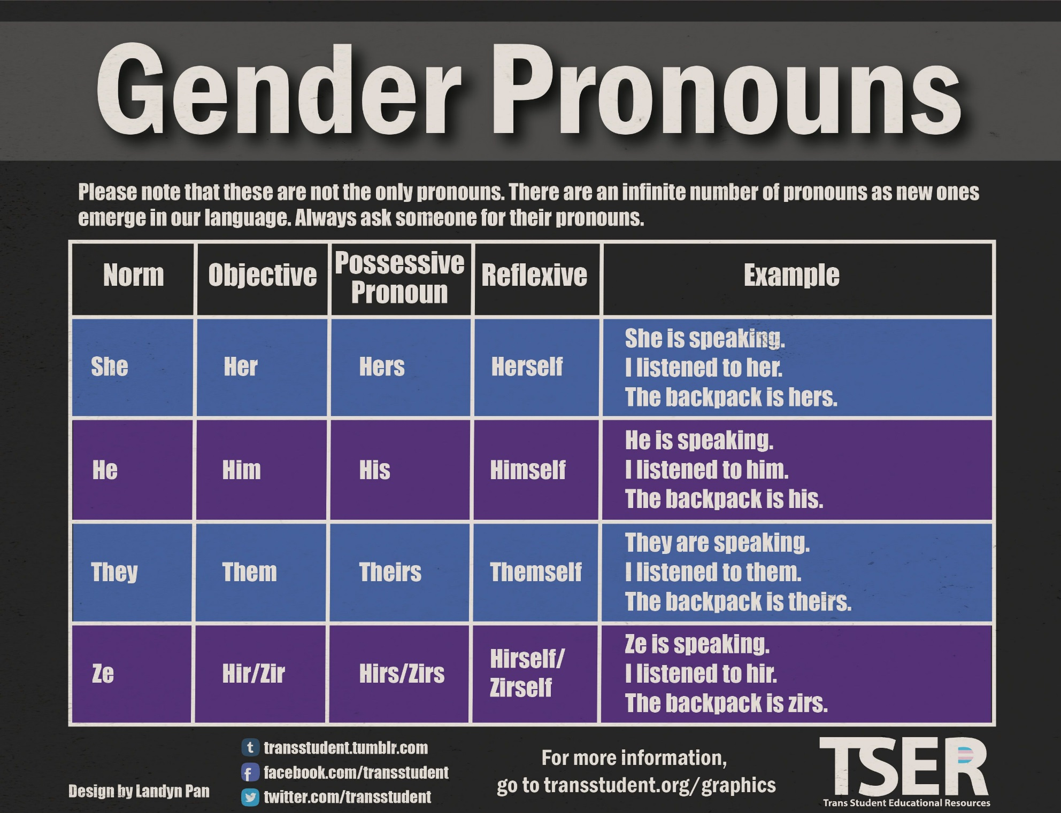

Slide 39
LGBTQ Health
Part 3: health disparities in the lgbt community

Slide 40
Access to Care
LGBT persons experience the same barriers to care as others including but not limited to:
  high cost of care
  inadequate or no insurance coverage
  lack of availability of services
  lack of culturally competent care
LGB adults are more likely to delay or not seek medical care
LGB adults are more likely to delay or not get needed prescription medicine
LGB adults are more likely to receive health care services in emergency rooms

Slide 41
Access to Care
Over 30% of transgender individuals have forgone preventative care due to fear of discrimination
8% of LGB individuals and 27% of transgender and gender-nonconforming persons reported being denied needed health care
11% of LGB patients reported that a healthcare provider that a health professional had refused to touch them or used excessive precautions
LGB individuals are more likely to have chronic conditions and earlier onset disabilities than heterosexual individuals

Slide 42
Behavioral Health
LGBTQ individuals are almost 3 times more likely than others to experience a mental health condition
In a national study, 40% of transgender adults reported having made a suicide attempt. 92% of these individuals reported having attempted suicide before the age of 25
Over half of the LGBTQ youth surveyed by the Trevor Project had been diagnosed with an eating disorder
96% of LGBTQ youth who had been diagnosed with bulimia had considered suicide
An estimated 20-30% of LGBTQ people abuse substances, compared to 9% of the general population

Slide 43
Behavioral Health
Lesbians are more likely to experience anxiety and depression than heterosexual women
Lesbians may experience chronic stress from discrimination. This stress increases for women who need to hide their orientation as well as for lesbians who have lost important emotional support because of their orientation
39% of transgender persons experienced serious psychological distress, compared with only 5% of the U.S. population
40% of transgender persons have attempted suicide in their lifetime, nearly nine times the rate in the U.S. population (4.6%)
Transgender persons who had received transition- related health care or wanted to have it someday had better mental health outcomes

Slide 44
Sexual Health
Gay and bisexual men accounted for 67% of new HIV infections in 2015
More than half of gay and bisexual men say that they have never discussed HIV with their doctor
1 in 6 gay and bisexual men will get HIV if current incident rate persists
  1 in 2 black MSM
  1 in 4 Latino MSM
  1 in 11 white MSM
1.2 million Americans are likely to benefit from using PrEP including 1 in 4 sexually active MSM
Nearly 1 in 5 black transgender women are living with HIV

Slide 45
Sexual Health
Bisexual women are twice as likely to have contracted an STI as their heterosexual counterparts
LGB youth report 2x higher rates of gonorrhea and chlamydia than heterosexual men
In 2014, MSM accounted for 83% of syphilis cases
MSM often get other sexually transmitted infections (STIs), including chlamydia and gonorrhea
MSM are 17 times more likely to get anal cancer than heterosexual men
Men who are HIV-positive are even more likely than those who do not have HIV to get anal cancer

Slide 46
Chronic Diseases
LGB individuals are more likely than heterosexuals to rate their health as poor, have more chronic conditions, and have higher prevalence and earlier onset of disabilities
LGB people report more asthma diagnoses, headaches, allergies, osteoarthritis, and gastro-intestinal problems than heterosexual individuals
Lesbian and bisexual women report poorer overall physical health and higher rates of asthma, urinary tract infections, and Hepatitis B and C than heterosexual
women
Gay and bisexual men report more cancer diagnoses and lower survival rates, higher rates of cardiovascular disease and risk factors, as well as higher total numbers of acute and chronic health conditions such as headaches and urinary incontinence than heterosexual men

Slide 47
Chronic Diseases
Bisexual women experience higher rates of cancer than the general population of women
Lesbian and bisexual women are less likely to receive mammograms
43% of lesbians have smoked tobacco in the past month compared to 16.7% of the general population
In a national study, 40% of lesbians under 23 reported being overweight compared to 25% of heterosexual women
LGB youth are more likely to be overweight

Slide 48
References
https://www.kff.org/report-section/health-and-access-to-care-and-coverage-for-lgbt-individuals-in-the-u-s-update-health-challenges/
http://files.kff.org/attachment/Issue-Brief-Health-and-Access-to-Care-and-Coverage-for-LGBT-Individuals-in-the-US
https://www.cdc.gov/nchhstp/newsroom/2016/croi-press-release-risk.html
https://www.cdc.gov/mmwr/preview/mmwrhtml/mm6446a4.htm?s_cid=mm6446a4_w
https://www.cdc.gov/msmhealth/viral-hepatitis.htm
https://www.cdc.gov/msmhealth/STD.htm
http://www.glma.org/index.cfm?fuseaction=Page.viewPage&pageID=691
https://assets2.hrc.org/files/assets/resources/HRC-BiHealthBrief.pdf?_ga=2.56644520.343806707.1520970779-1128215697.1517334474
https://www.lgbthealtheducation.org/wp-content/uploads/LGBTHealthDisparitiesMar2016.pdf
https://transequality.org/sites/default/files/docs/usts/USTS-Executive-Summary-Dec17.pdf

Slide 49
LGBTQ Health
Part 4: best practices

Slide 50
Initial Contact
Frontline staff need to be educated on sensitivity to gender variance and sexual orientation when answering the phone/scheduling appointments
  Do not assume a caller’s gender based on the sound of their voice or name; use their name, not their pronoun
  Do not make a big deal out of someone using a name/gender that may not match their legal documentation and/or insurance records
  Make space (or set an alert) for clear notes on any names or pronouns a caller specifically asks your staff to use when they come in for their appointment
  Use language that assures them they are being taken seriously, and that they are not a burden in any way

Slide 51
Walking Through the Door
Visible signs of support in entry and waiting areas
  Safe space stickers – LGB and T
  LGBTQ-inclusive imagery (posters, brochures, etc)
  Anti-discrimination policy posted
Frontline staff need to be educated on sensitivity not only on the phone, but also when greeting the patient
  Do not ask unnecessary questions about name or gender at the reception desk
  If there are questions regarding how to bill insurance, discuss this in a private setting away from other patients
  Check the patient in just as you would anyone else
  Make a habit of looking at notes (or alerts) to see how the patient would like to be addressed BEFORE calling their name in the waiting room
All-Gender Restrooms & Other Accommodations

Slide 52
Intakes
  Allow for gender variance (not just M or F)
  Separate gender identity and sex assigned at birth (Federal Register)
  Separate spaces for legal name and chosen name, in case name has not been changed legally (This can be helpful even for people with nicknames)
  Ask sexual orientation
  In obtaining parental medical history, this should read “Parent #1/Parent #2”, rather than “Mother/Father”
  Obtain sexual history information to determine risk factors
    Inquire whether they want an HIV test & when was their last one
    Inquire about number of sexual partners & frequency of sexual activity
    Ask what types of sex they are having (oral, anal, vaginal, etc)
    Keep in mind that just because someone says they identify as straight, this might not match sexual behaviors

Slide 53
Judgment-Free Communication
  Use name & pronouns the patient wants
  Ask the two basic questions:
    What sex were you assigned at birth?
    What is your gender?
      Also important for patient safety and insurance coding
  Use demographic information from intake forms to address health disparities that are specific to the patient’s identity
  Reflect language the patient uses to talk about their body
  When you are uncertain of a term… “Tell me what that means for you”
  Do not assume everyone is straight or cisgender (i.e. never start a conversation about sexual history or behaviors by asking a female patient “do you have a boyfriend”?)

Slide 54
Judgment-Free Communication
  Continue the conversation about sexual health:
    Discuss what body parts are used for sex & how
    Discuss realistic ways of protecting one’s sexual health & alternatives for sexual pleasure (Harm Reduction)
    Become educated on PEP & PrEP
    Educate patients on getting tested for HIV every three months
    Know what types of STI screenings a person should receive (i.e. STI’s of the throat and anus often go undetected/untreated due to inadequate screenings)
  All of this said, if a patient is seeing you for a cold or sprained ankle, a conversation about sexual health may not be warranted

Slide 55
Resources
http://www.lgbthealtheducation.org/wp-content/uploads/13-017_TransBestPracticesforFrontlineStaff_v6_02-19-13_FINAL.pdf
http://transhealth.ucsf.edu/trans?page=lib-00-02
https://www.ama-assn.org/delivering-care/creating-lgbtq-friendly-practice
https://www.liebertpub.com/doi/pdf/10.1089/lgbt.2015.0136
https://www.federalregister.gov/
https://www.wpath.org/publications/soc

Slide 56
Tentative 2019 Meeting Dates
Thursday, February 14
Wednesday, April 10
Wednesday, June 12
Wednesday, August 7
Wednesday, October 16
Wednesday, December 11
All meetings
9:30 – 11:30 am
Locations TBD
www.lihealthcollab.org

Slide 57
Adjournment
www.lihealthcollab.org

